Slide 1
Tripster
Your trip collaborator

Slide 2
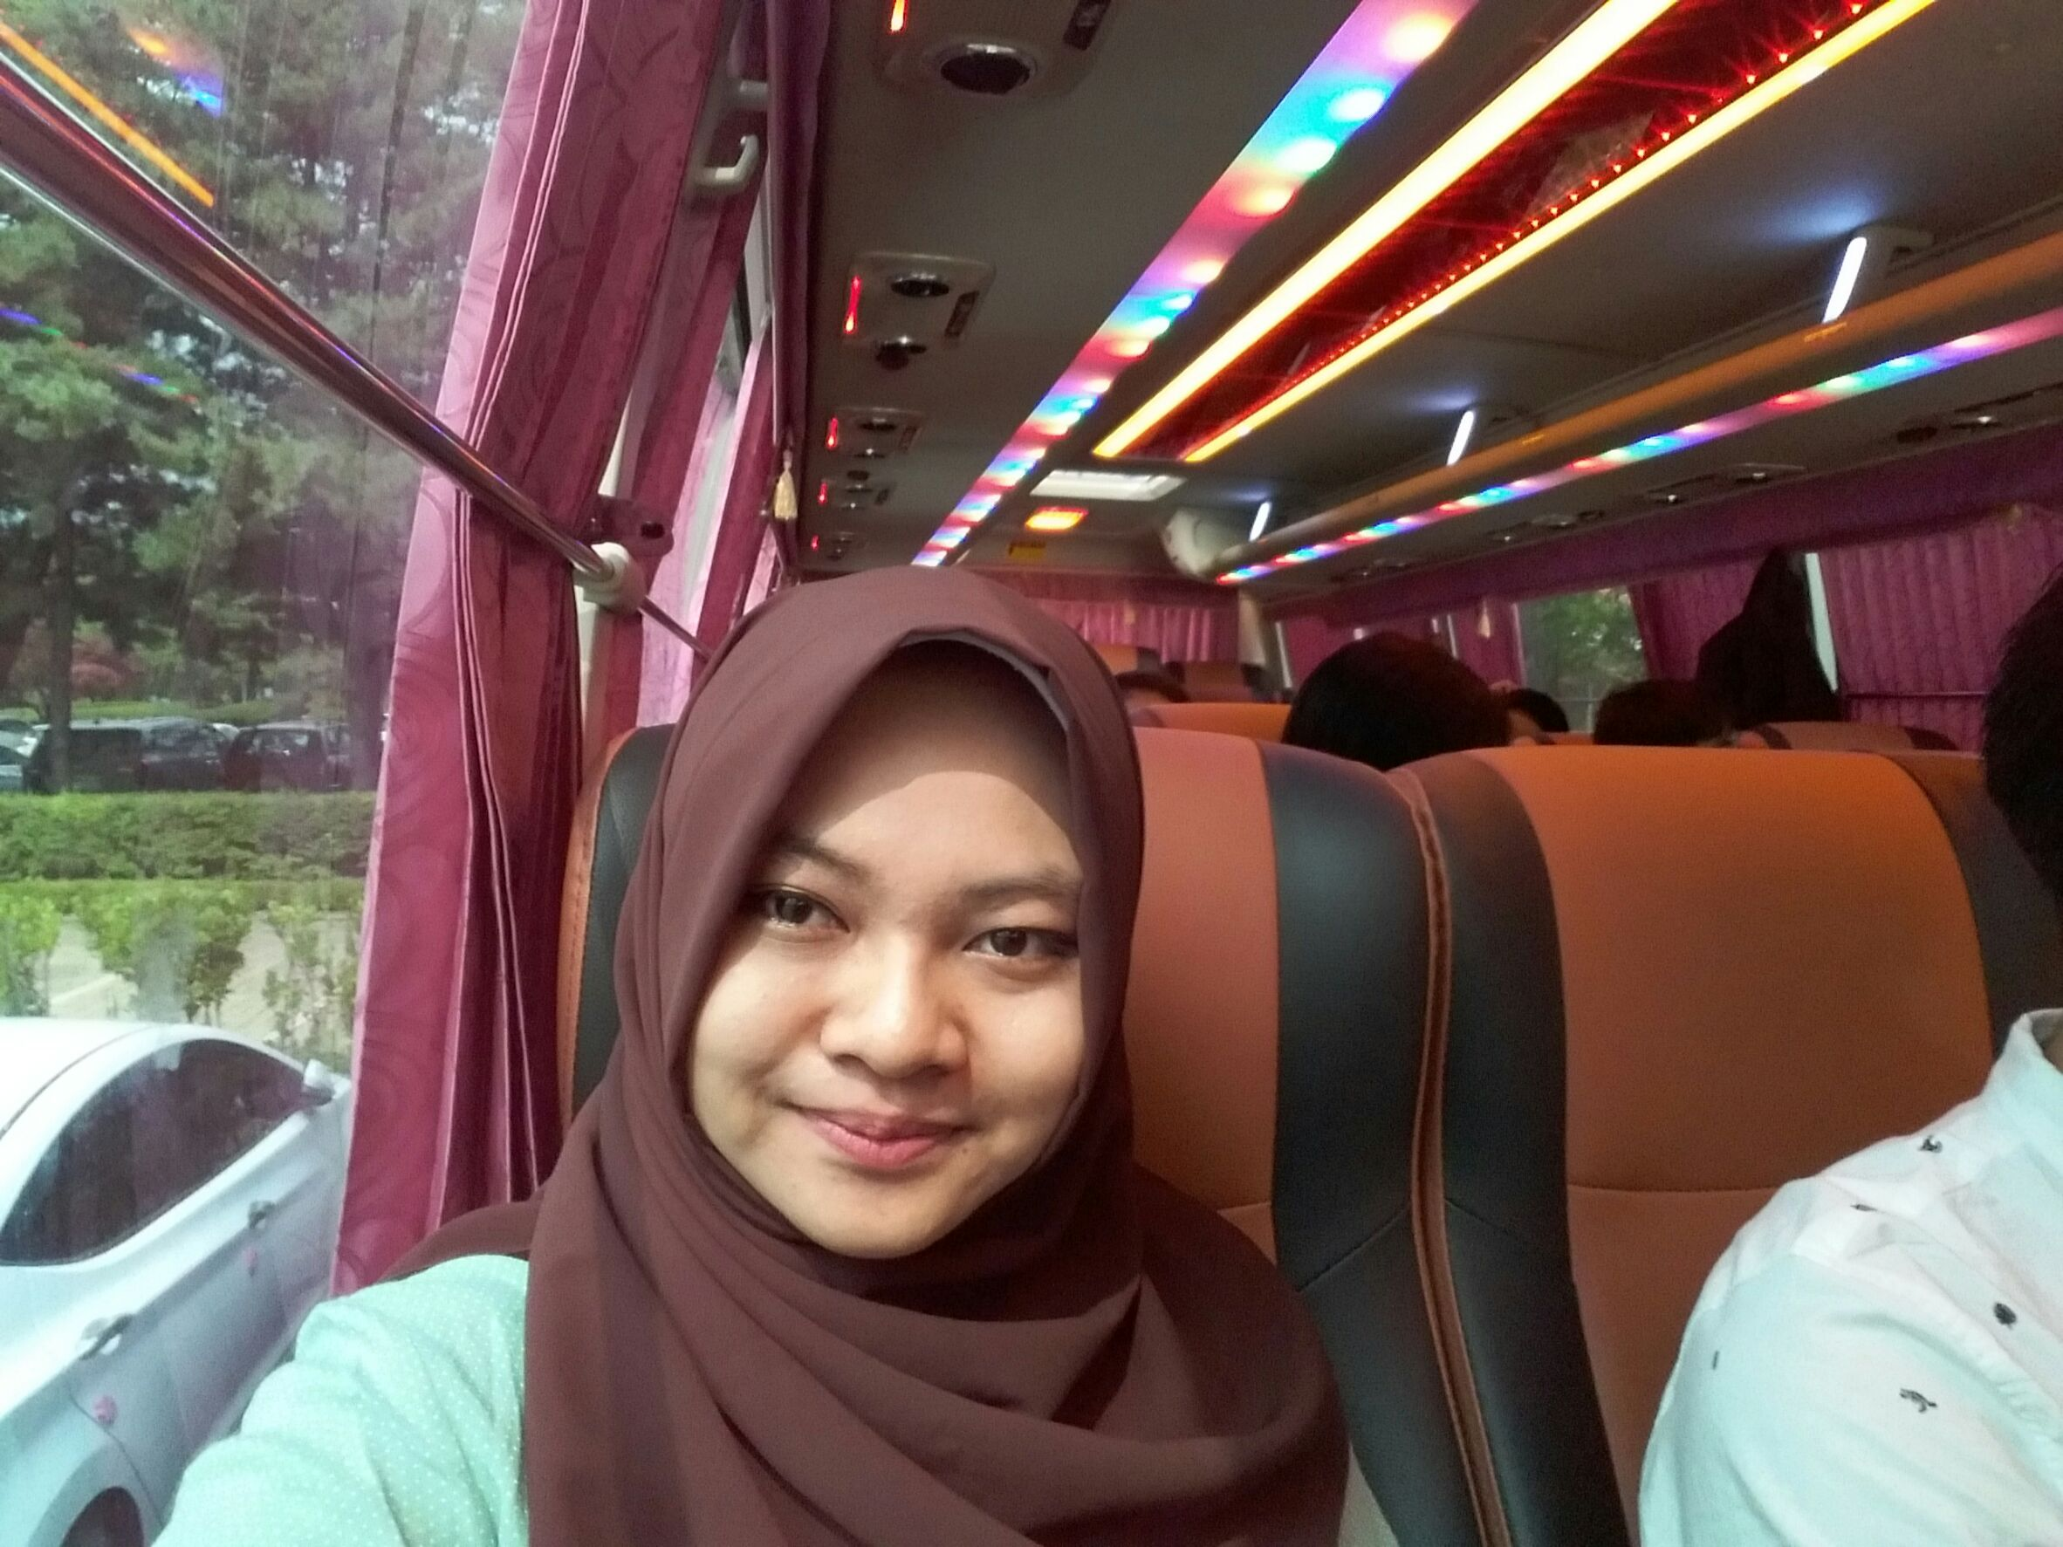
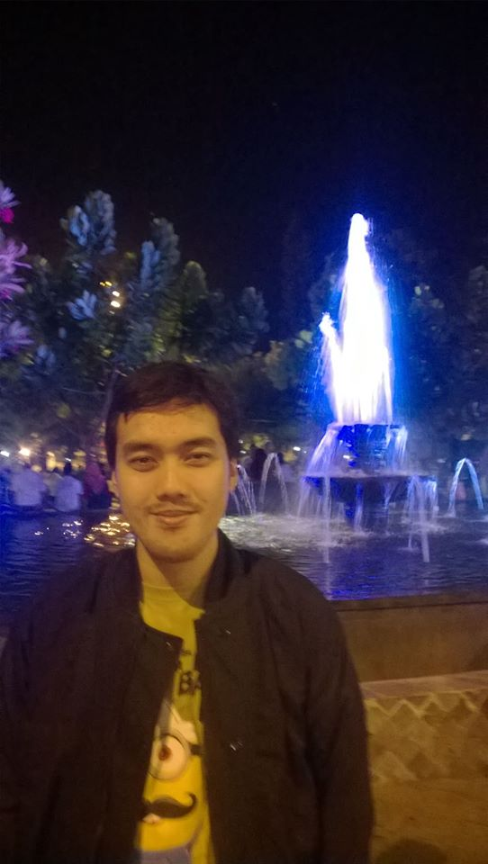

Teams
Iffah
Wildan
Indra

Slide 3
Contents
Executive Summary
Background
Objective
Architecture
Core Code & Demo
Executive Summary | Background | Objective | Architecture | Core Code & Demo

Slide 4



Trip announcement among close friend based on web service
Many people in a circle has their own plan for trip, some of the plan will be better to do together.
2
3
1
Roles In the TRIP
Basic Requirement
Planning Interface
Executive Summary | Background | Objective | Architecture | Core Code & Demo

